Slide 1

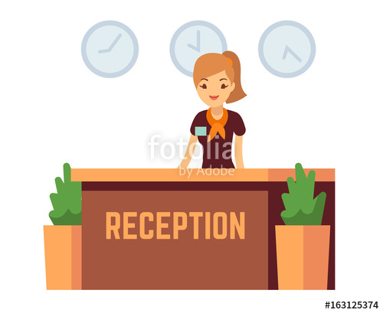
ONLINE RESERVATION SYSTEM

Slide 2
BUSINESS MODEL

Slide 3
An online reservation system works by processing secure online reservations made through a spa’s website. The data is then passed onto a backend system which can be accessed by manage bookings. Other features that come with it – for example, the automation of reservation confirmation through email.

Slide 4
NATURE OF BUSINESS

Slide 5






Hotel Reservation
Product and Services

Slide 6
CONCEPT OF OPERATION

Slide 7
MISSION
To develop a generic system that is capable of making reservation fast and easy transaction.
VISION
The online reservation systems of companies will have various functions and will be effective in terms of accuracy of data. In addition, they will provide a hassle free transaction for customers.

Slide 8
OBJECTIVES
is to develop a reservation system to help them solve underlying problems with their manual reservation system such as consuming money and effort. Moreover, it is also essential to deliver a good service for clients using the following objectives:

Slide 9
OBJECTIVES
To help speed up the process of hotel reservation
To shift from manual reservation process to a standardized online reservation process
To reduce the amount of time to and effort consume by the customer to reserve.
To provide user account and password to ensure the security of stored files.
To least their expenses in making reservation.

Slide 10
DATA FLOW

Slide 11
CONTEXT DIARAM
CLIENT
ADMIN
Transaction Handling
User Handling
Payment
Receipt
Order Reservation
Reservation Handling
RESERVATION SYSTEM
User Information
Validate Account
Reservation
Information
Confirmation or Select
Transaction
Information
Admin Activity Report
Sales Report
User Report
User Handling
Metadata Handling
Transaction
Handling
Reservation Handling
OWNER

Slide 12
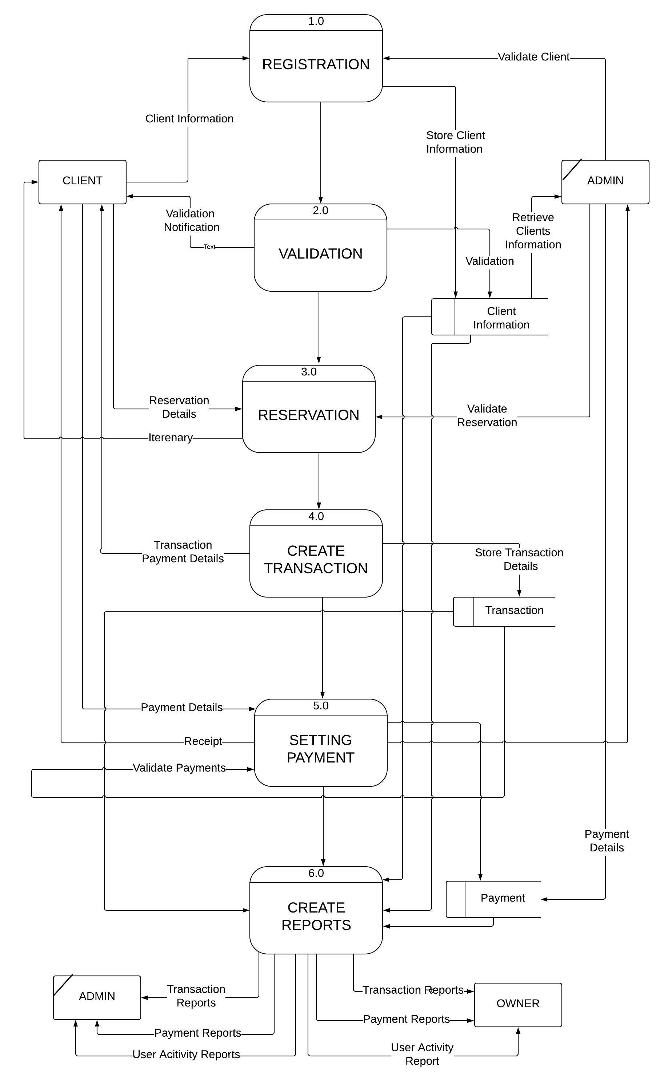
TOP LEVEL DATA DIAGRAM

Slide 13
ENTITY RELATIONSHIP

Slide 14
IDENTIFICATION OF IDENTITIES
ADMIN – Responsible in user handling, reservation handling and transaction handling.
OWNER – takes charge in creating reports such as sales reports, user reports and admin activity report.
CLIENT – makes order and making payments

Slide 15
ERD
Transaction & Payment Confirmation
User_id
Username
User_acessrights
ADMIN
User_id
Username
User_acessrights
Reservation_id
Payment_id
CLIENT
REPORTS -Account Activity -Reservations
-Transactions
User_id
Username
User_acessrights
OWNER

Slide 16

USED CASE DIAGRAM
TRANSACTION
ADMIN
REPORTS
MAINTENANCE
CLIENT
ABOUT US
PAYMENT
OWNER

Slide 17
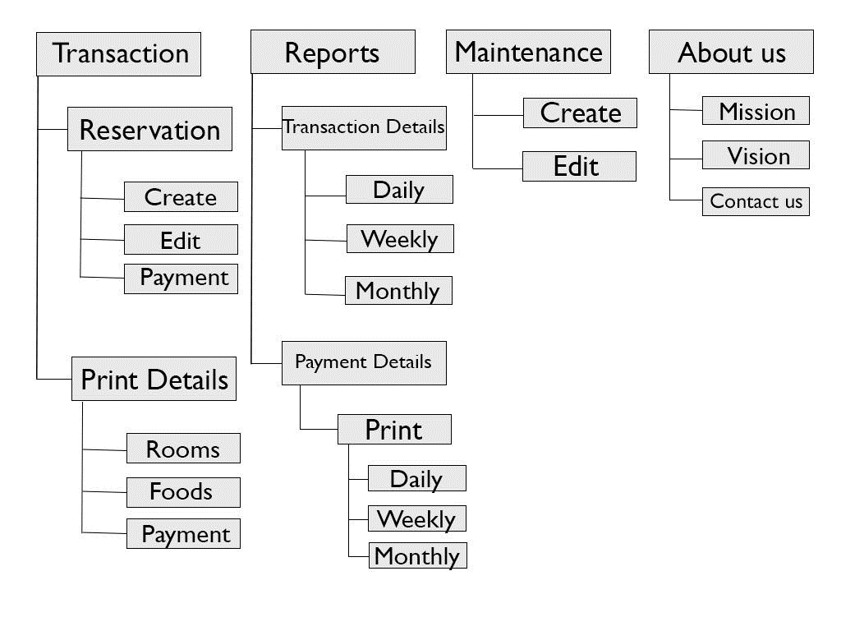
HIPO DIAGRAM

Slide 18
Prepared by:
ALINGALAN, CARL DENNIS M.
BELARDO, JEAN MAE C.
CASTILLO, JOEL JUDE B.
ESPINAS, AILA MAE M.
MANALO, RICA MAE M.

